Slide 1

academic support at Birkbeck
Notes:
Starting your course can be difficult
Jargon & academic conventions, e.g. essay writing, referencing, etc can be confusing.
But don’t worry as there is a lot of support available.
You will have a personal tutor & module lecturers to advise you.
Students can also have many of their queries resolved by talking to their course administrator.
There are many people & resources to support you if you require guidance in your studies.

Slide 2




Learning Development Tutors
Eva Szatmari – maths & statistics
e.szatmari@bbk.ac.uk
MAL 707
Dan McVeagh – maths & statistics
d.mcveagh@bbk.ac.uk
MAL 707
Richard Carabine – writing skills and general study skills
r.carabine@bbk.ac.uk
MAL 715a
Andrew Silverman – English language
business-englishsupport@bbk.ac.uk
Notes:
We run academic development workshops in September and throughout the academic year.
We also offer one-to-ones and small group tutorials.
We also offer Skype tutorials.
Andrew to offer 3 hours p.w. as a pilot to identify demand for English language support
Returning to study & motivation Reading & note-taking skills
Essay writing Referencing
Giving presentations Taking part in seminars
Managing time and workload Avoiding plagiarism
Writing a dissertation English
Coping with exams
Pre-Algebra Formulae
Equations Functions
Basic calculus Basic statistics
Basic data analysis

Slide 3
academic skills workshops
School of BEI http://www.bbk.ac.uk/mybirkbeck/global/workshop_timetable?orgunit=BU
Central Birkbeck http://www.bbk.ac.uk/mybirkbeck/global/workshop_timetable?orgunit=GLOBAL

Slide 4
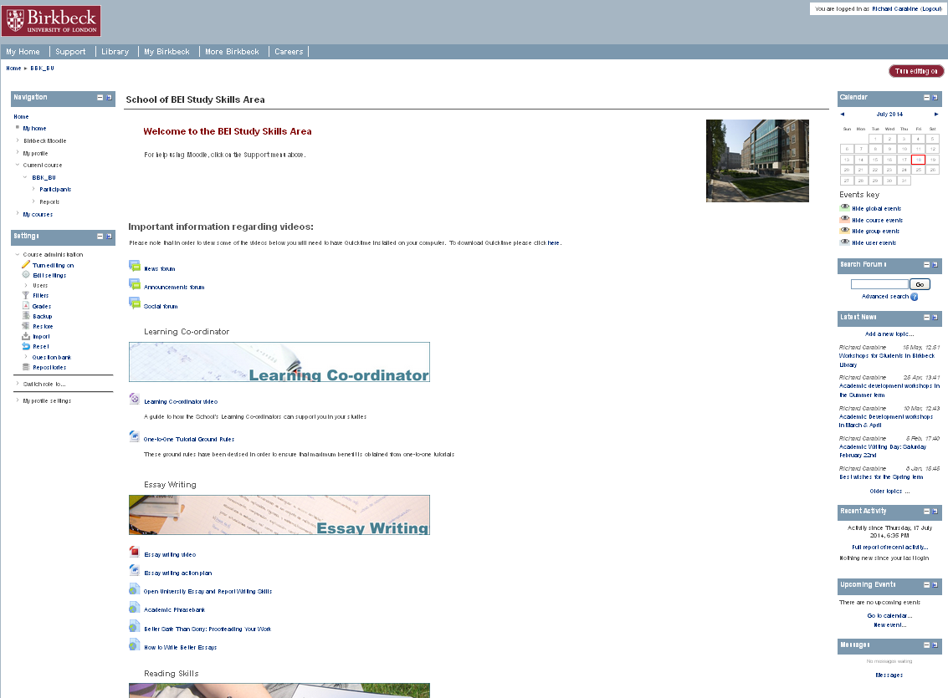
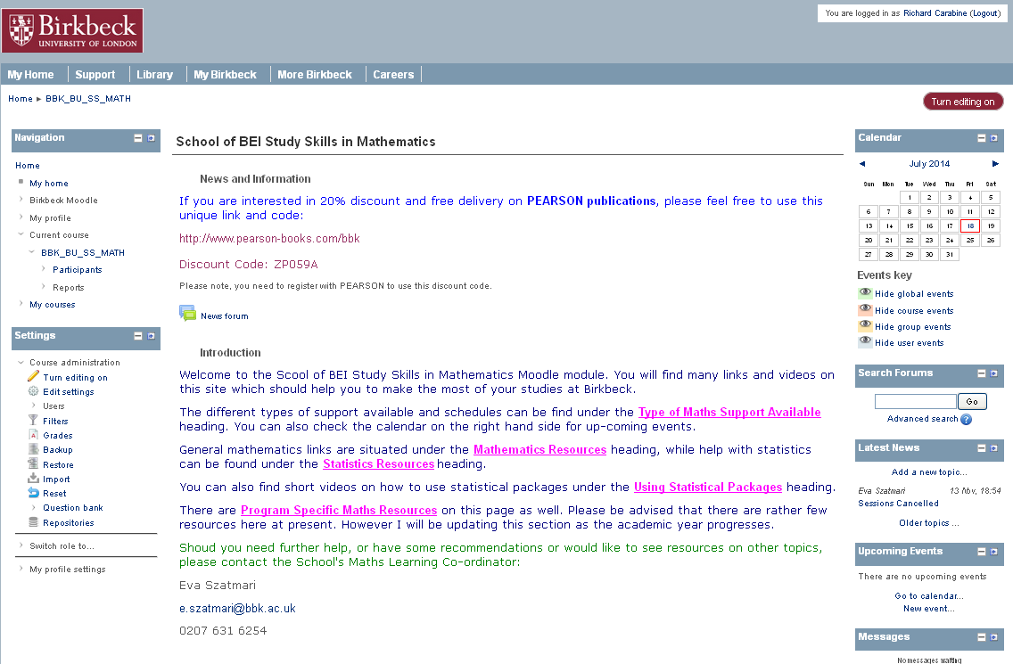
Moodle
School of BEI Study Skills in Mathematics
https://moodle.bbk.ac.uk/course/view.php?id=7759
School of BEI Study Skills
https://moodle.bbk.ac.uk/course/view.php?id=12219
Notes:
There are Moodle areas where students can find tutorials, resources & links to materials.
Also recordings of workshops available here.
This is useful when students cannot attend workshops or are network learners.

Slide 5
Birkbeck Learning Skills
https://moodle.bbk.ac.uk/course/view.php?id=7881
Resources from Birkbeck Workshops https://moodle.bbk.ac.uk/mod/book/view.php?id=163030&chapterid=547
Online materials and workshop resources for academic English https://moodle.bbk.ac.uk/mod/book/view.php?id=163030&chapterid=888
Notes:
Resources from Birkbeck Workshops(Key: c = core skills, m = master skills, d = disability & dyslexia resources)
We offer a range of workshops for students wanting to improve their academic skills. To book on any of our workshops please see the Academic Development Calendar. Below you will find resources, such as slides, handouts and recordings, from our workshops.
Introduction to essay writing slides, recording (c)
Writing for postgraduates slides, recording (m)
Using your reading in your essays slides (c)
Writing a postgraduate literature review slides (m)
What is academic English? slides (c)
Writing style and developing a writing voice slides, recording (m)
Introduction to citing, references lists and plagiarism slides (c)
Using Zotero for managing your references and citations slides (m)
Starting Zotero recording (0.44 mins) (m)
Collecting references with Zotero recording (3.40 mins) (m)
Entering references manually on Zotero recording (1.25 mins) (m)
Using Evernote to manage your research slides, handout (m)
Using Google forms to design online surveys slides, recording (m)

Slide 6
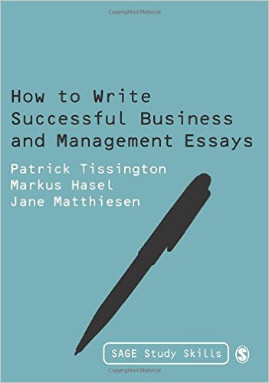
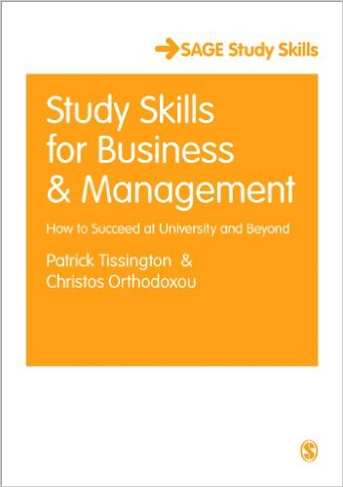
Notes:
Tissington – How to write successful business & management essays
Amazon –£15.75 More buying choices £3.93 used & new(51 offers)
Tissington – Study skills for business & management
Amazon - £15.78 More buying choices £13.14 used & new (43 offers)
Make sure you have an overview of the course and understand how each module fits into the whole award.
Work out how the course has been put together and how it’s being assessed.
Read the assignment question at the beginning of the course, not the end. If there are exams, check out past papers at the beginning. All this gives you a sense of how the course is organised and what you are doing each week.
Read the journals to gain an idea of how to argue & write in your subject.
Create a glossary of those technical terms & specialist language.
Plan hour-long study sessions followed by a break. In this way you can remain motivated & maintain your concentration. Long study sessions are not the best way of studying. You could sit there for hours without engaging with the material.

Slide 7
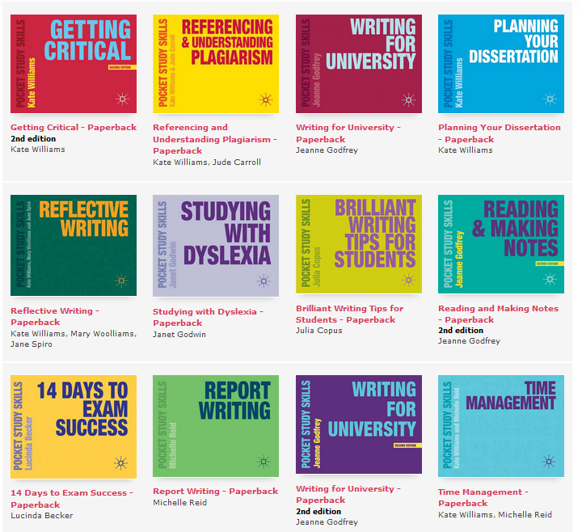
Palgrave
MacMillan
pocket
study
skills
Notes:
Some are available in the Birkbeck Library
I have ordered copies of all of them

Slide 8
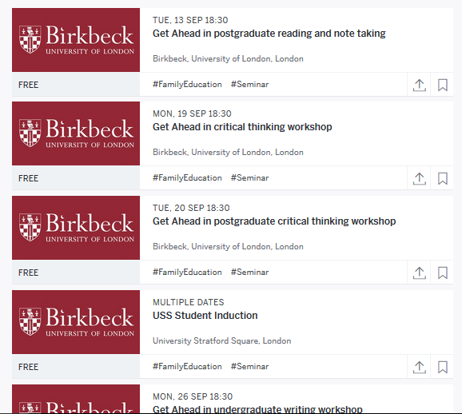
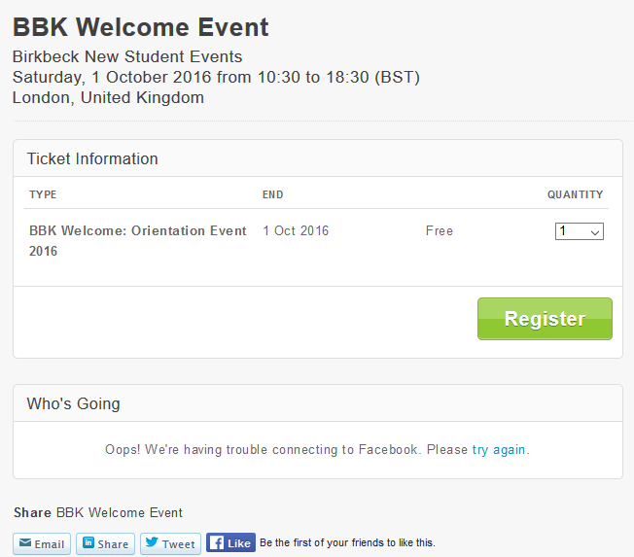
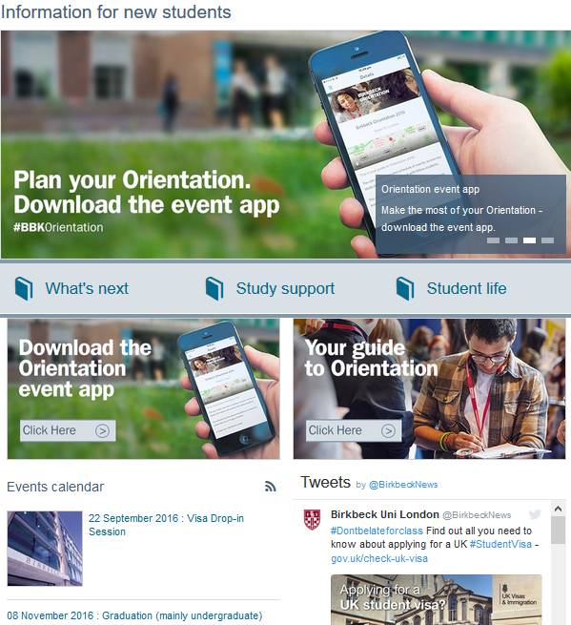
pre-entry support
& activities
http://www.eventbrite.co.uk/o/birkbeck-new-student-events-4726184317
https://www.eventbrite.co.uk/e/bbk-welcome-event-tickets-26581584234
http://www.bbk.ac.uk/mybirkbeck/aig
Notes:
Orientation app & Org Psych app
BBK Welcome Event – Saturday 1st October (10.30 to 6.30)
It's a day of talks, tours and social activities, giving you an opportunity to network with fellow students and learn more about the services and resources available at Birkbeck.
Birkbeck New Student Events
Events designed to introduce and prepare new students for studying at Birkbeck, University of London.

Slide 9
additional support & resources
disability & dyslexia support http://www.bbk.ac.uk/mybirkbeck/services/facilities/well-being-service/disability
careers http://www.bbk.ac.uk/careers
get ahead: stay ahead http://www.bbk.ac.uk/mybirkbeck/get-ahead-stay-ahead
time & management skills http://www.mindtools.com/
using english for academic purposes http://www.uefap.com/writing/writfram.htm
Notes:
Disability & dyslexia support
Careers
Birkbeck provides careers advice, events and information services for current students and GradClub members. We can support you by:
Offering confidential 1:1 careers coaching and interview practice
Advice and resources on managing your career
Access to internships and jobs
Resources on starting your own business and student enterprise.
Student Union
Academic issues Accommodation
Money Advice Employment rights
Consumer Rights Legal
International Student Issues Homesickness, fees and general and local information. Visa issues are supported through the International Office and the College Registry (due to Home Office regulations).
Get Ahead: Stay Ahead
interactive tutorials will help you consider how you can achieve your goals, find out what studying at Birkbeck is like and improve your academic skills.
Considering studying Studying at Birkbeck
Academic skills Academic support
Writing skills Exams
Maths skills PhD support

Slide 10
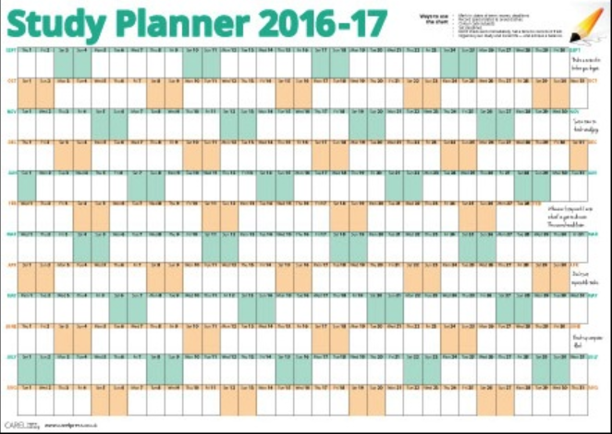
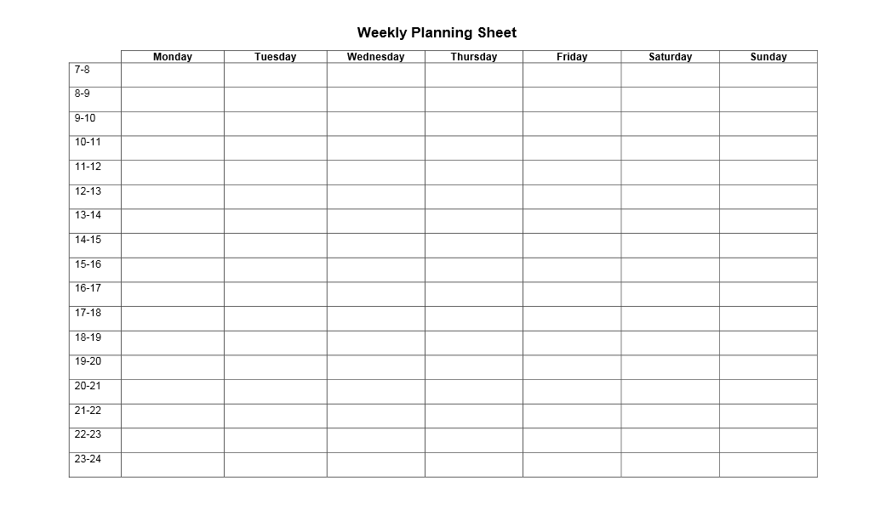
use a diary & study planner
Identify your tasks
Break them down into manageable chunks
Schedule tasks
Time Planning Sheets http://www.lboro.ac.uk/library/skills/planningSheets.html
Notes:
Use a Study Planner & weekly timetable/diary
Write in all deadlines, meeting dates, lectures, tutorials, seminars, exams, birthdays, social events to a study planner, along with any other significant dates. This makes your busy times instantly visible.
You must then add your work, family, leisure & other commitments so you can see at-a-glance your commitments over the coming weeks & months.
You can see if there are any clashes or deadlines coming close together.
You can then break down your study into chunks in a weekly plan or diary. For example, “read chapter 2 of set textbook and make notes” or “write up lecture notes”.
For a large task like an essay, you need to break this up into smaller sub-tasks, e.g. Analyse question and brainstorm key points
Regularly check your study calendar - be aware of approaching deadlines so there are no surprises.
Most people tend to plan their schedule and to-do list on a daily basis.
A more effective time frame is a week – plan out what you need to achieve each day across a whole week.
It is a more long-term technique to manage yourself.
This can be quite difficult to do, especially when you have never done it before. (Tissington Study Skills)

Slide 11
study tips
try and study with other students
make sure you do the pre-lecture reading so that you have a grasp of the topic
go through your notes afterwards to consolidate what you have learned
don’t delay - ask for help if you need it
plan where you are going to study outside of lectures
use the study planner to organise your time & tasks
Notes:
Study with other students
Research shows that students who study with others routinely achieve better grades.
You don’t always have to be in the same room – you can communicate on-line using something like Goole Docs
Where to study
Find somewhere you can work productively where you have all the materials you need, free from interruptions and distractions.
Create a study space where you feel organised and able to do academic work.
Get yourself organised
Set up a simple filing system – like a box file for each module and use it for lecture notes, notes from reading, handouts, etc.
Students can get overwhelmed trying to remember everything form every lecture & reading – well you don’t have to remember everything, you just need to know where to find this information when you need it for an assignment or for revision.
You don’t have unlimited time
Accept you may have to compromise in your study and cover only the essentials.
This will help to keep you in control.
You have to make maximum use of the study time you have at your disposal.
If you spend too much time on a particular task, that will leave you less time for another.

Slide 12
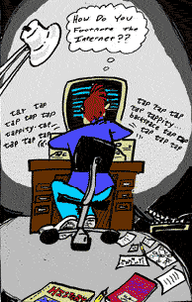
good luck with your studies at Birkbeck!

